Slide 1
Software Engineering
UNIT-3
USER INTERFACE DESIGN

Slide 2
USER INTERFACE DESIGN
The visual part of a computer application or operating system through which a client interacts with a computer or software.
It determines how commands are given to the computer or the program and how data is displayed on the screen.

Slide 3
Types of User Interface
There are two main types of User Interface:
Text-Based User Interface or Command Line Interface
Graphical User Interface (GUI)

Slide 4
Text-Based User Interface
This method relies primarily on the keyboard.
Example of this interface is UNIX.

Slide 5
Advantages
Many and easier to customizations options.
Typically capable of more important tasks.

Slide 6
Disadvantages
Relies heavily on recall rather than recognition.
Navigation is often more difficult.

Slide 7
Graphical User Interface (GUI)
GUI relies much more heavily on the mouse.
Example of this type of interface is any versions of the Windows operating systems.

Slide 8
GUI Characteristics
GUI Characteristics
Characteristics | Descriptions
Windows | Multiple windows allow different information to be displayed simultaneously on the user's screen.
Icons | Icons different types of information. On some systems, icons represent files. On other icons describes processes.
Menus | Commands are selected from a menu rather than typed in a command language.
Pointing | A pointing device such as a mouse is used for selecting choices from a menu or indicating items of interests in a window.
Graphics | Graphics elements can be mixed with text or the same display.

Slide 9
Advantages
Less expert knowledge is required to use it.
Easier to Navigate and can look through folders quickly in a guess and check manner.
The user may switch quickly from one task to another and can interact with several different applications.

Slide 10
Disadvantages
Typically decreased options.
Usually less customizable. Not easy to use one button for tons of different variations.

Slide 11
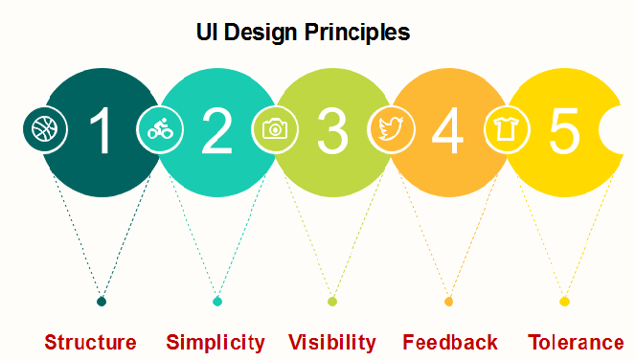
UI Design Principles

Slide 12
Structure:
Design should organize the user interface purposefully, in the meaningful and usual based on precise, consistent models that are apparent and recognizable to users.
The structure principle is concerned with overall user interface architecture.

Slide 13
Simplicity: The design should make the simple, common task easy, communicating clearly and directly in the user's language, and providing good shortcuts that are meaningfully related to longer procedures.

Slide 14
Visibility: The design should make all required options and materials for a given function visible without distracting the user with extraneous or redundant data.

Slide 15
Feedback: The design should keep users informed of actions or interpretation, condition, and bugs or exceptions that are relevant and of interest to the user through clear, concise, and familiar to users.

Slide 16
Tolerance: The design should be flexible and tolerant, decreasing the cost of errors and misuse also preventing bugs wherever possible by tolerating varied inputs and sequences and by interpreting all reasonable actions.

Slide 17
Unified Process model
The unified process model (or UPM is an iterative, incremental, architecture-centric, and use-case driven approach for developing software.
.

Slide 18
Phases of Unified Process Model
Inception:
In which you collect requirements from the customer and analyze the project's feasibility, its cost, risks, and profits
Communication and planning are the main ones.

Slide 19
Customers’ requirements are identified and then it becomes easy to make a plan for the project
The project plan, Project goal, risks, use-case model, and Project description, are made.
The project is checked against the milestone criteria and if it couldn’t pass these criteria then the project can be either canceled or redesigned.

Slide 20
Elaboration –
  Planning and modeling are the main ones.
  A detailed evaluation and development plan is carried out and diminishes the risks.
  Revise or redefine the use-case model (approx. 80%), business case, and risks.

Slide 21
  Again, checked against milestone criteria and if it couldn’t pass these criteria then again project can be canceled or redesigned.
  Executable architecture baseline.

Slide 22
Construction :
  The project is developed and completed.
  System or source code is created and then testing is done.
  Coding takes place.

Slide 23
Transition :
  The final project is released to the public.
  Transit the project from development into production.
  Update project documentation.
  Beta testing is conducted.
  Defects are removed from the project based on feedback from the public.

Slide 24
Production :
  The final phase of the model.
  The project is maintained and updated accordingly.

Slide 25
Advantages:
It provides good documentation, it completes the process in itself.
It provides risk-management support.
It reuses the components, and hence total time duration is less.
Good online support is available in the form of tutorials and training.

Slide 26
Disadvantages:
Team of expert professional is required, as the process is complex.
Complex and not properly organized process.
More dependency on risk management.
Hard to integrate again and again.

Slide 27
Characteristics of a user interface
Speed of learning. A good user interface should be easy to learn. Speed of learning is hampered by complex syntax and semantics of the command issue procedures. A good user interface should not require its users to memorize commands.

Slide 28
Speed of use. Speed of use of a user interface is determined by the time and user effort necessary to initiate and execute different commands.
Speed of recall. Once users learn how to use an interface, the speed with which they can recall the command issue procedure should be maximized.

Slide 29
Error prevention. A good user interface should minimize the scope of committing errors while initiating different commands.
Attractiveness. A good user interface should be attractive to use. In this respect, graphics-based user interfaces have a definite advantage over text-based interfaces.
Consistency. The commands supported by a user interface should be consistent. Consistency facilitates speed of learning, speed of recall, and also helps in reduction of error rate.
Feedback. A good user interface must provide feedback to various user actions.

Slide 30
Error recovery (undo facility). While issuing commands, even the expert users can commit errors. Therefore, a good user interface should allow a user to undo a mistake committed by him while using the interface.
User guidance and on-line help. Users seek guidance and on-line help when they either forget a command or are unaware of some features of the software. Whenever users need guidance or seek help from the system, they should be provided with the appropriate guidance and help.

